Slide 1

K-Nearest Neighbours and ML Basics
Machine Learning for Electronics Engineers
Shivin Srivastava
Slides Adapted from CS441 UIUC

Slide 2
Today’s Lecture
Overview of machine learning process
K-Nearest Neighbor Algorithm
Measuring and understanding error

Slide 3
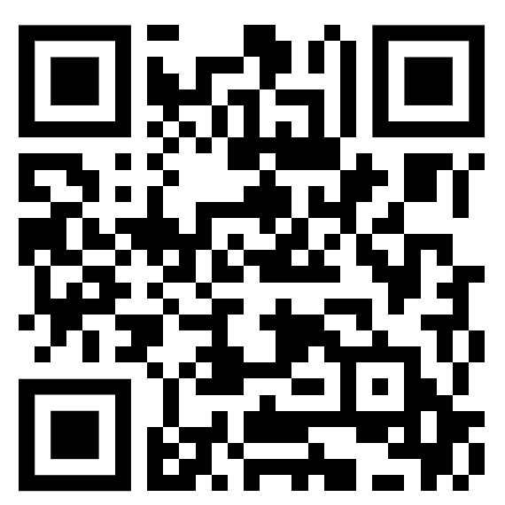
Quiz
Time: 10 minutes

Slide 4
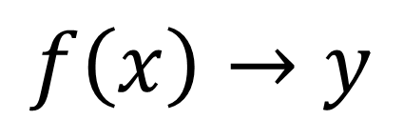
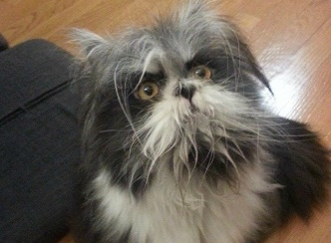
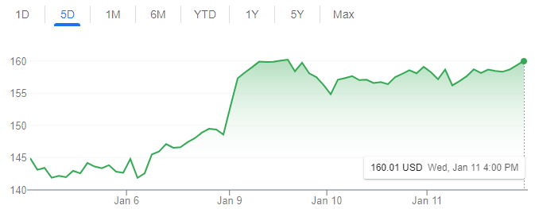
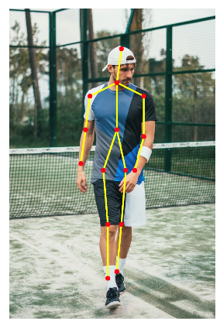
Machine learning model maps from features to prediction
Features
Prediction
Examples
Classification
Is this a dog or a cat?
Is this email spam or not?
Regression
What will the stock price be tomorrow?
What will be the high temperature tomorrow?
Structured prediction
What is the pose of this person?

Slide 5
Learning has three stages
Training: optimize model parameters
Validation: intermediate evaluations to design/select model
Test: final performance evaluation

Slide 6
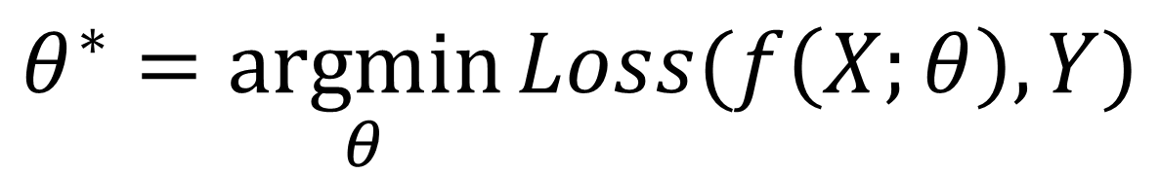


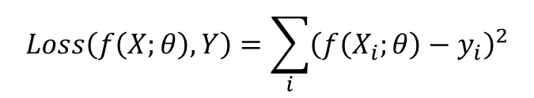

Training: the model is fit to data to minimize a loss or maximize an objective function
Model parameters that minimize loss
Features of all training examples
“Ground Truth” predictions of all training examples
Loss: sum squared error
Example
Learn to predict next day’s temperature given preceding days’ temperatures
37.5 | 41.2 | 51.0 | 48.3
47.0 | 46.5 | 48.9 | 50.5
…
67.0 | 64.7 | 63.0 | 61.4
50.5
47.6
…
60.2
1 row per example
Model: linear
1 column per feature
Optimization via ordinary least squares regression

Slide 7
Model design and “hyper parameter” tuning is performed using a validation set
neural network
Select model
Set training parameters
Feature selection
Learning rate, regularization parameters, …
Sometimes, there are clear “train”, “val”, and “test” sets. Other times, you need to split “train” into a train set for learning parameters and a val set for checking model performance

Slide 8
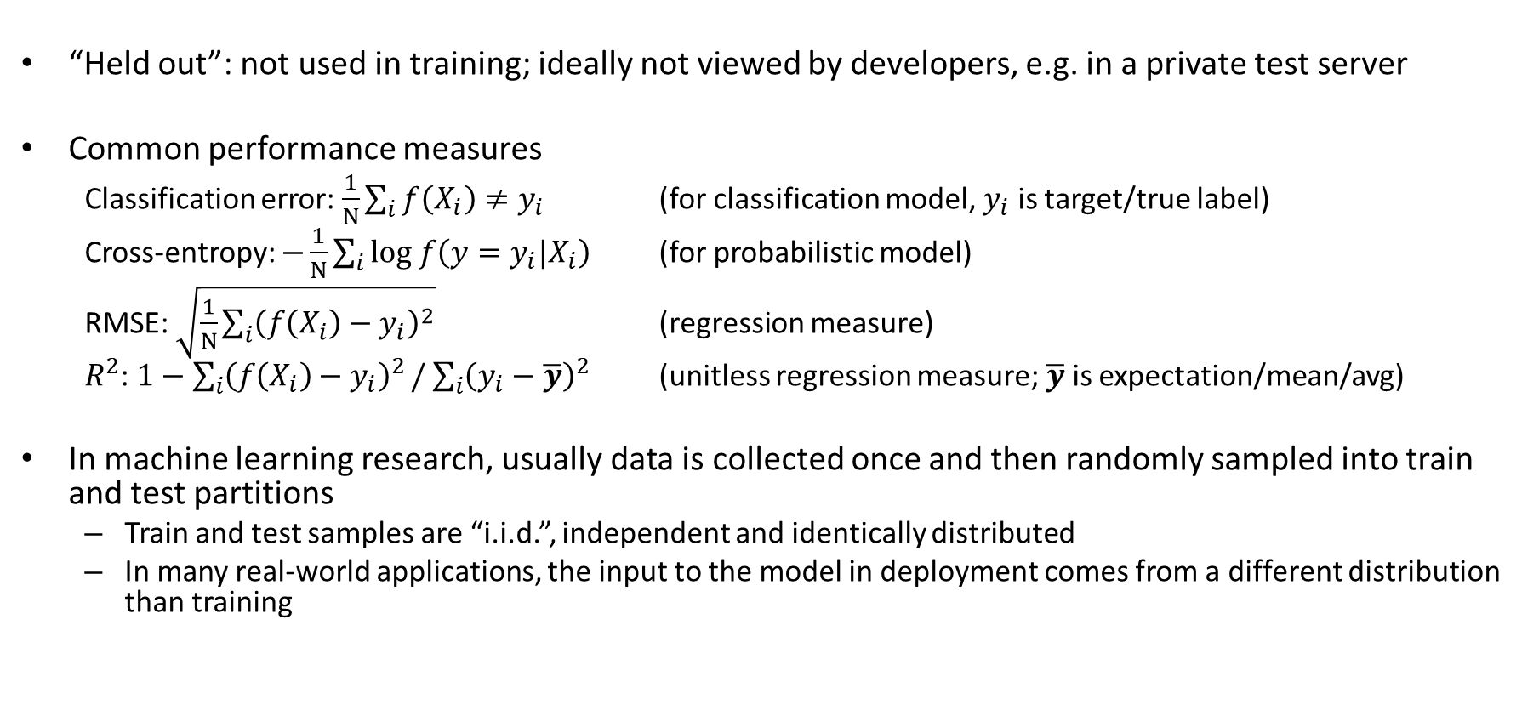
Testing: The effectiveness of the model is evaluated on a held out test set

Slide 9
Recap of training and evaluation
Modify design based on initial results
Model/Training Design
Validate Model
Validation Data
Train
Model
Evaluate model design
Training Data
Test Model
Test Data
Final evaluation

Slide 10
What class do you think the ‘+’ belongs to?
x
x
x
o
x
x
x
+
o
x
o
x
o
o
o
o
x2
x1

Slide 11
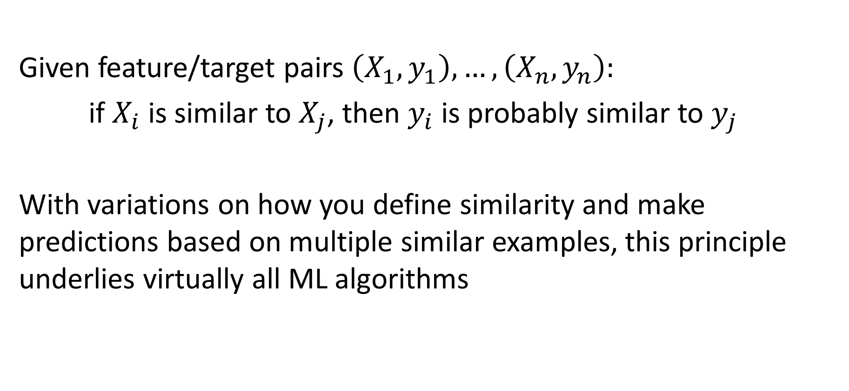
Key principle of machine learning

Slide 12
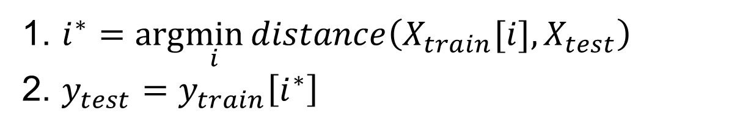
Nearest neighbor algorithm
For given test features, assign the label / target value of the most similar training features
Distance function is up to designer. Simplest is L2 distance.

Slide 13
K-nearest neighbor: predict based on K closest training samples
x
x
x
o
x
x
x
+
o
o
x
x
o
o
+
o
o
x2
x1

Slide 14
1-nearest neighbor
x
x
x
o
x
x
x
+
o
o
x
x
o
o
+
o
o
x2
x1

Slide 15
3-nearest neighbor
x
x
x
o
x
x
x
+
o
o
x
x
o
o
+
o
o
x2
x1

Slide 16
5-nearest neighbor
x
x
x
o
x
x
x
+
o
o
x
x
o
o
+
o
o
x2
x1

Slide 17
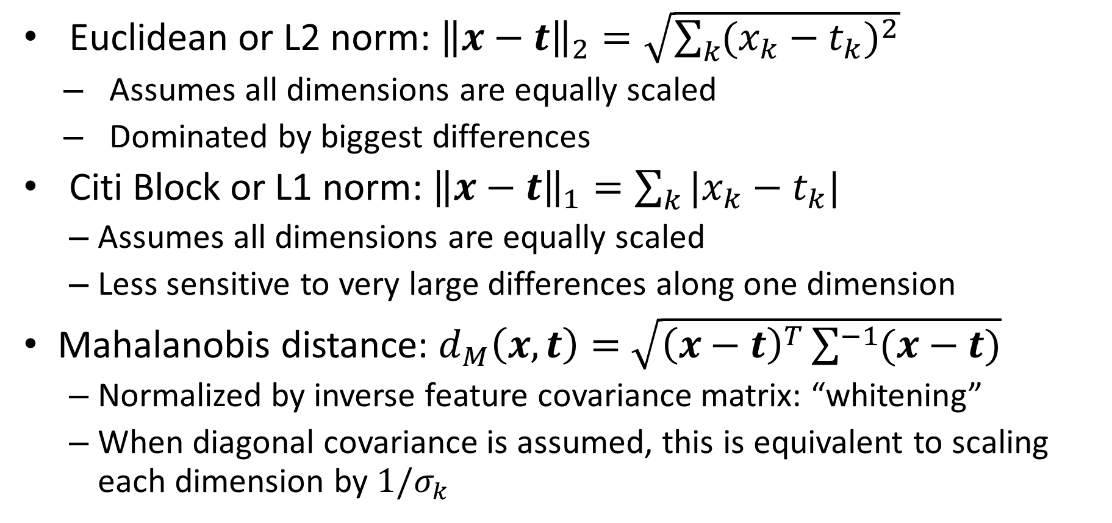
KNN Distance Function

Slide 18
KNN Classification vs Regression
For classification, prediction is usually the mode or most common class of the returned labels
For regression, prediction is usually the arithmetic mean (average, informally) of the returned values

Slide 19
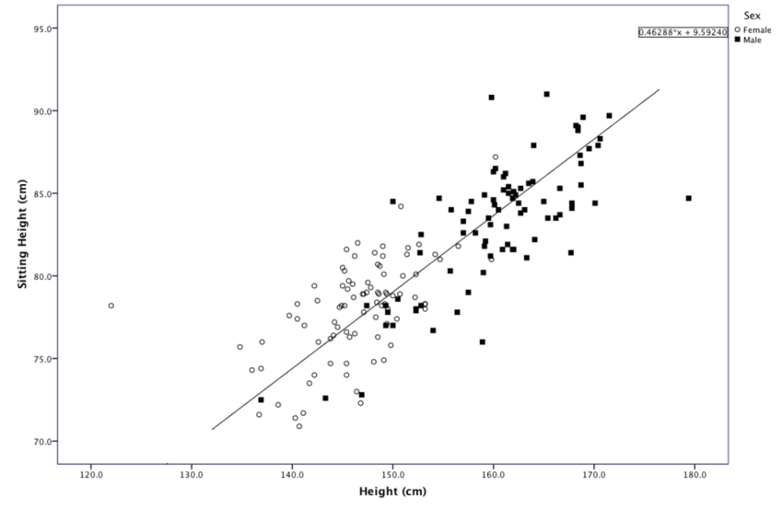
o
+
x
Predict sex from standing/sitting heights
https://www.researchgate.net/figure/Scatter-plot-of-Sitting-Height-over-Height-for-males-and-females_fig3_301724988

Slide 20
x
+
Predict sitting height from standing height
https://www.researchgate.net/figure/Scatter-plot-of-Sitting-Height-over-Height-for-males-and-females_fig3_301724988

Slide 21
KNN Classification Demos
https://lecture-demo.ira.uka.de/knn-demo/#
http://vision.stanford.edu/teaching/cs231n-demos/knn/

Slide 22
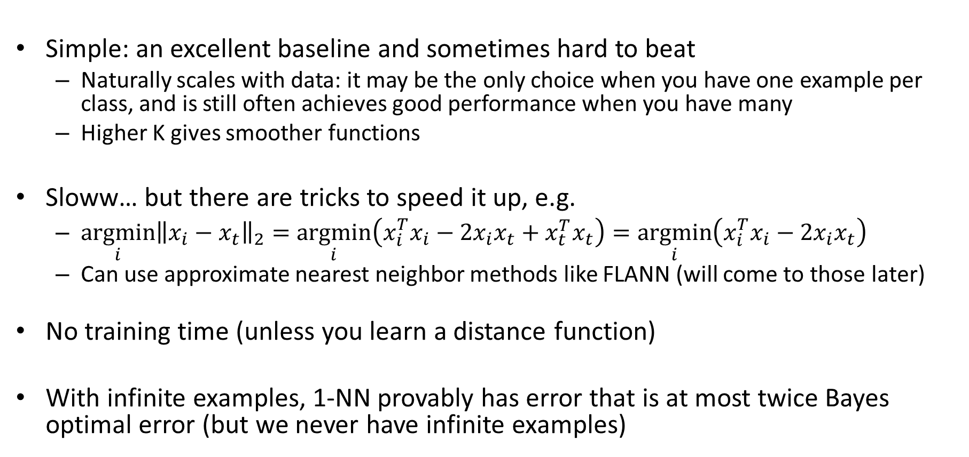
Comments on K-NN
can be precomputed

Slide 23
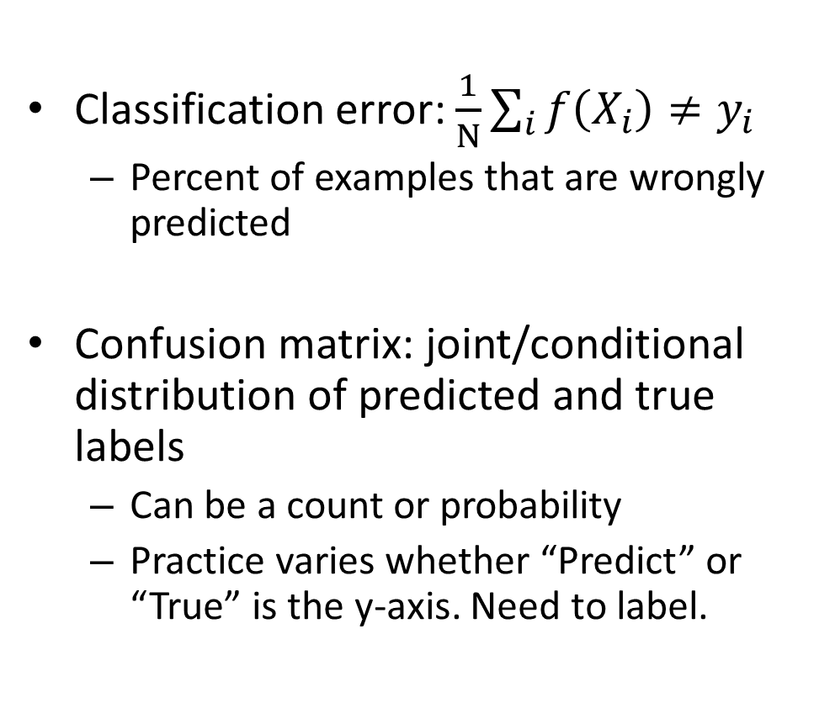
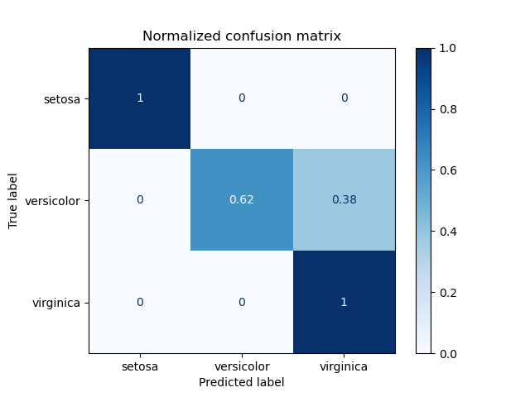
How do we measure and analyze classification error?
https://scikit-learn.org/stable/auto_examples/model_selection/plot_confusion_matrix.html

Slide 24
Measuring error example
Confusion Matrix:
Count
True | Predicted
Y | Y
N | Y
Y | Y
Y | N
N | N
N | Y
N | N
 |  | Predicted
 |  | N | Y
True | N
 | Y
Classification Error:
P(predicted | true)
 |  | Predicted
 |  | N | Y
True | N
 | Y

Slide 25
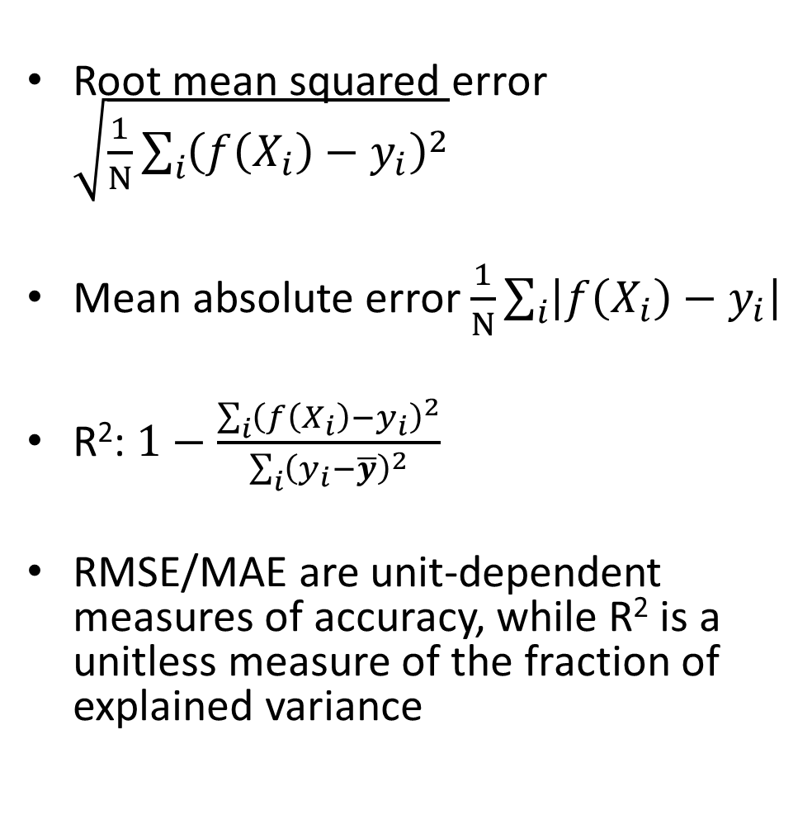
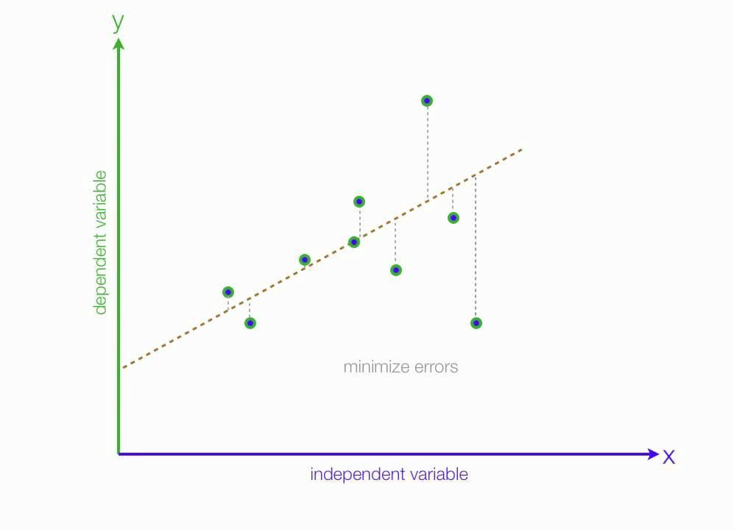
How do we measure and analyze regression error?
(unexplained variance)
(total variance)
Fig: https://medium.com/analytics-vidhya/mae-mse-rmse-coefficient-of-determination-adjusted-r-squared-which-metric-is-better-cd0326a5697e

Slide 26
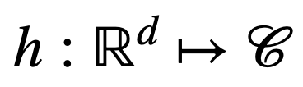
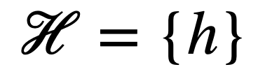
Mathematical formulation of the pipeline
Dataset:
Hypothesis:
Hypothesis Class:

Slide 27
Mathematical formulation of the pipeline
Dataset:
Hypothesis:
Hypothesis Class:
E.g. a Neural Network based classifier that maps image to label of cat or dog
i.e. a large family of NNs with different parameters

Slide 28
Train, Test and Validation Set - Intuition
https://mlu-explain.github.io/train-test-validation/

Slide 29
Sources of test error for a trained model
Intrinsic: sometimes it is not possible to achieve zero error given available features (e.g. handwriting, weather prediction)
Bayes optimal error: The error if the true function P(y|x) is known
Model Bias: the model is limited so that Bayes optimal error cannot be achieved for an infinite training set
Model Variance: given finite training data, different parameters and predictions would result from different samplings of data
Distribution Shift: some examples are more likely in test than training, i.e. true P(x) is different for train and test
E.g., datasets are collected at different times and frequency of content has changed
Function Shift: P(y|x) is changed between train and test
E.g., the predicted answer to “What is your favorite TV show?” changes over time
Others: imperfect optimization, final performance measure is different than training loss

Slide 30
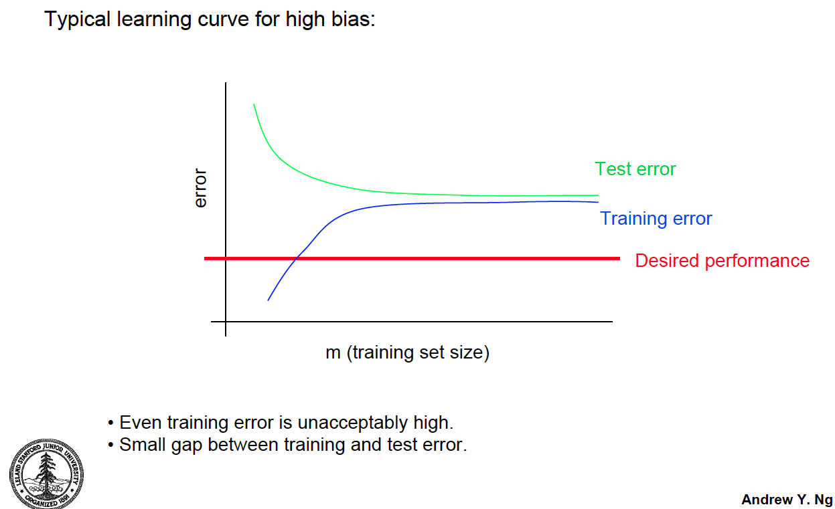
Effect of Training Size

Slide 31
Sources of error and training size
Fixed model
Due to limited training data (model variance) and distribution shift
Testing
Error
Test error with infinite training examples
Due to difference in P(y|x) in training and test (function shift)
Train error with infinite training examples
Training
Number of Training Examples
Due to limited power of model (model bias) and unavoidable intrinsic error (Bayes optimal error)

Slide 32

Overfitting and Underfitting
Intuition: Machine Learning Fundamentals: Bias and Variance

Slide 33
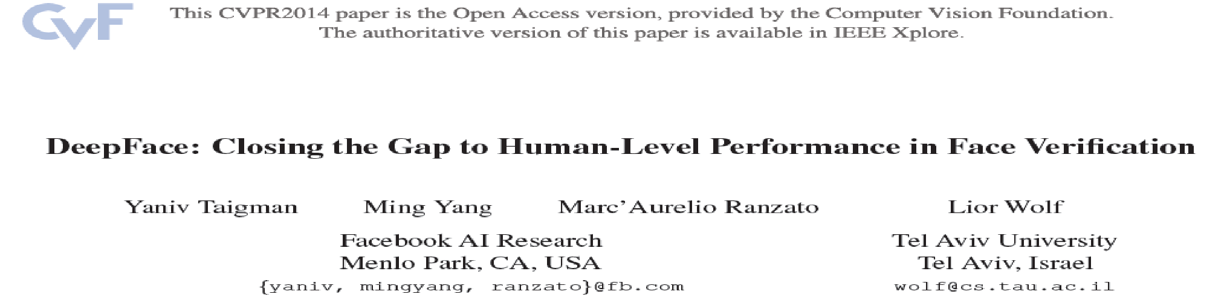
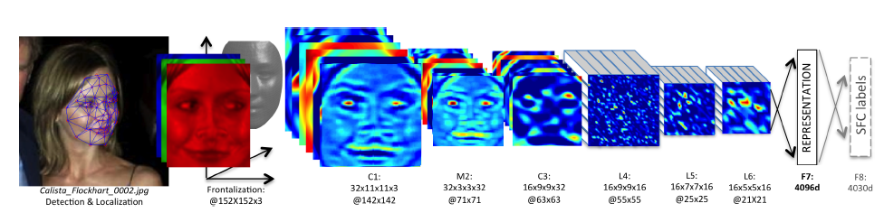
KNN Usage Example: Deep Face
CVPR 2014
Detect facial features
Align faces to be frontal
Extract features using deep network while training classifier to label image into person (dataset based on employee faces)
In testing, extract features from deep network and use nearest neighbor classifier to assign identity
Performs similarly to humans in the LFW dataset (labeled faces in the wild)
Can be used to organize photo albums, identifying celebrities, or alert user when someone posts an image of them
If this is used in a commercial deployment, what might be some unintended consequences?
This algorithm is used by Facebook (though with expanded training data)

Slide 34
KNN Summary
Key Assumptions
Samples with similar input features will have similar output predictions
Depending on distance measure, may assume all dimensions are equally important
Model Parameters
Features and predictions of the training set
Designs
K (number of nearest neighbors to use for prediction)
How to combine multiple predictions if K > 1
Feature design (selection, transformations)
Distance function (e.g. L2, L1, Mahalanobis)
When to Use
Few examples per class, many classes
Features are all roughly equally important
Training data available for prediction changes frequently
Can be applied to classification or regression, with discrete or continuous features
Most powerful when combined with feature learning
When Not to Use
Many examples are available per class (feature learning with linear classifier may be better)
Limited storage (cannot store many training examples)
Limited computation (linear model may be faster to evaluate)

Slide 35
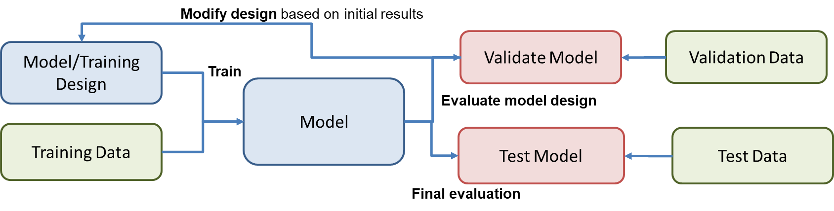
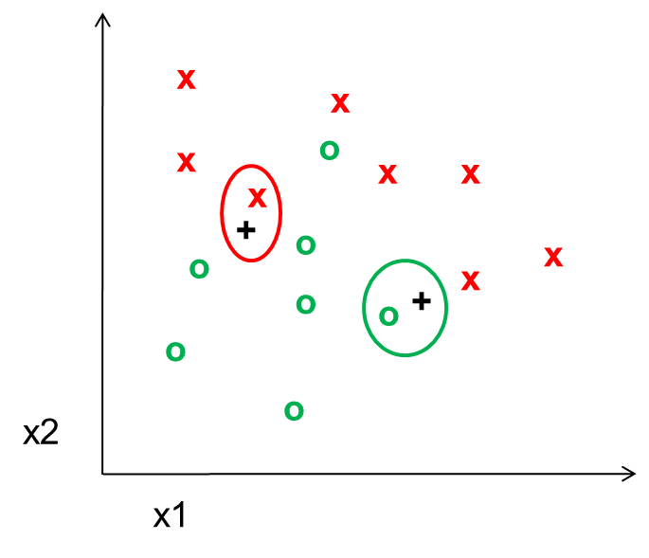
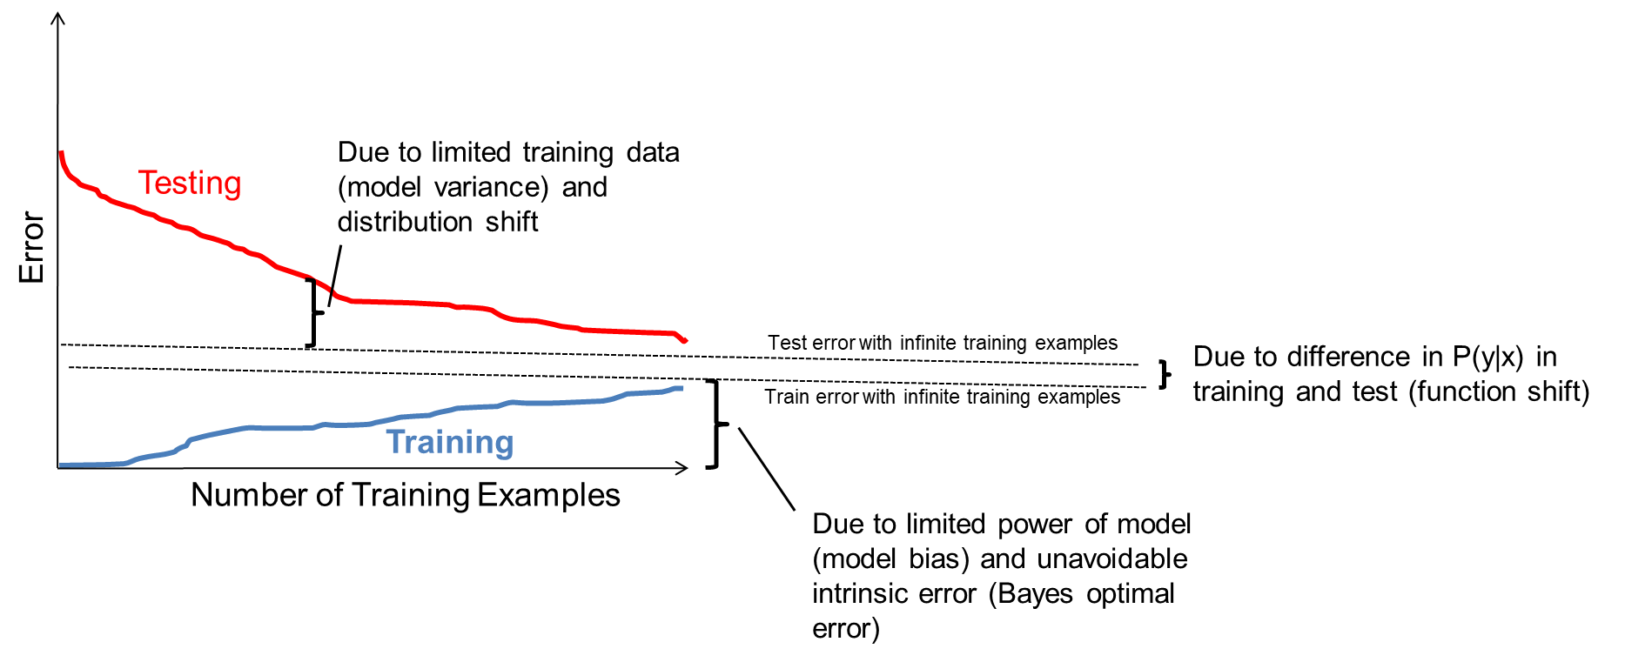
Things to remember
Supervised machine learning involves:
Fitting parameters to a model using training data
Refining the model based on validation performance
Evaluating the final model on a held out test set
KNN is a simple but effective classifier/regressor that predicts the label of the most similar training example(s)
With more samples, fitting the training data becomes harder, but test error is expected to decrease
Test errors have many sources
intrinsic to problem
model bias / limited power
model variance / limited training data
differences in training and test distributions
Model design and fitting is just one part of a larger process in collecting data, developing, and deploying models

Slide 36
Next week
Probabilistic models and Naïve Bayes
Linear and Logistic Regression

Slide 37
Thank You!
Any Questions?

